Slide 1

Easy Auction
Log in
Email/Phone number
Password
Sign up
Forgot your password?

Slide 2
Easy Auction
Trouble logging in?
A recovery code will be sent to
Email
Submit

Slide 3
Easy Auction
Enter your code below
Verification code
Submit

Slide 4
Easy Auction
Please enter your new password
Password
Confirm password
Submit

Slide 5
Easy Auction
Sign up
Username
Email
Phone number (optional)
Password
Confirm Password
Sign up

Slide 6
Easy Auction
Auctions I’m bidding in
Auction I’m hosting
Enter a local code to join an auction:
Host an Auction
Join Auction

Slide 7
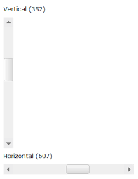
Easy Auction
Auctions I’m bidding in
Auction I’m hosting
Logan School
Auction
50 current bidders
0 current bidders
Dog Sweater
Yardsale
Bovine Goods
Extravaganza
3 current bidders

Slide 8
Account
Change password
Set profile pic
Item history
Easy Auction
Auctions I’m bidding in
Auction I’m hosting
Logan School
Auction
50 current bidders
0 current bidders
Dog Sweater
Yardsale
Admin Dashboard
My auctions
Start a new auction
Bovine Goods
Extravaganza
3 current bidders

Slide 9


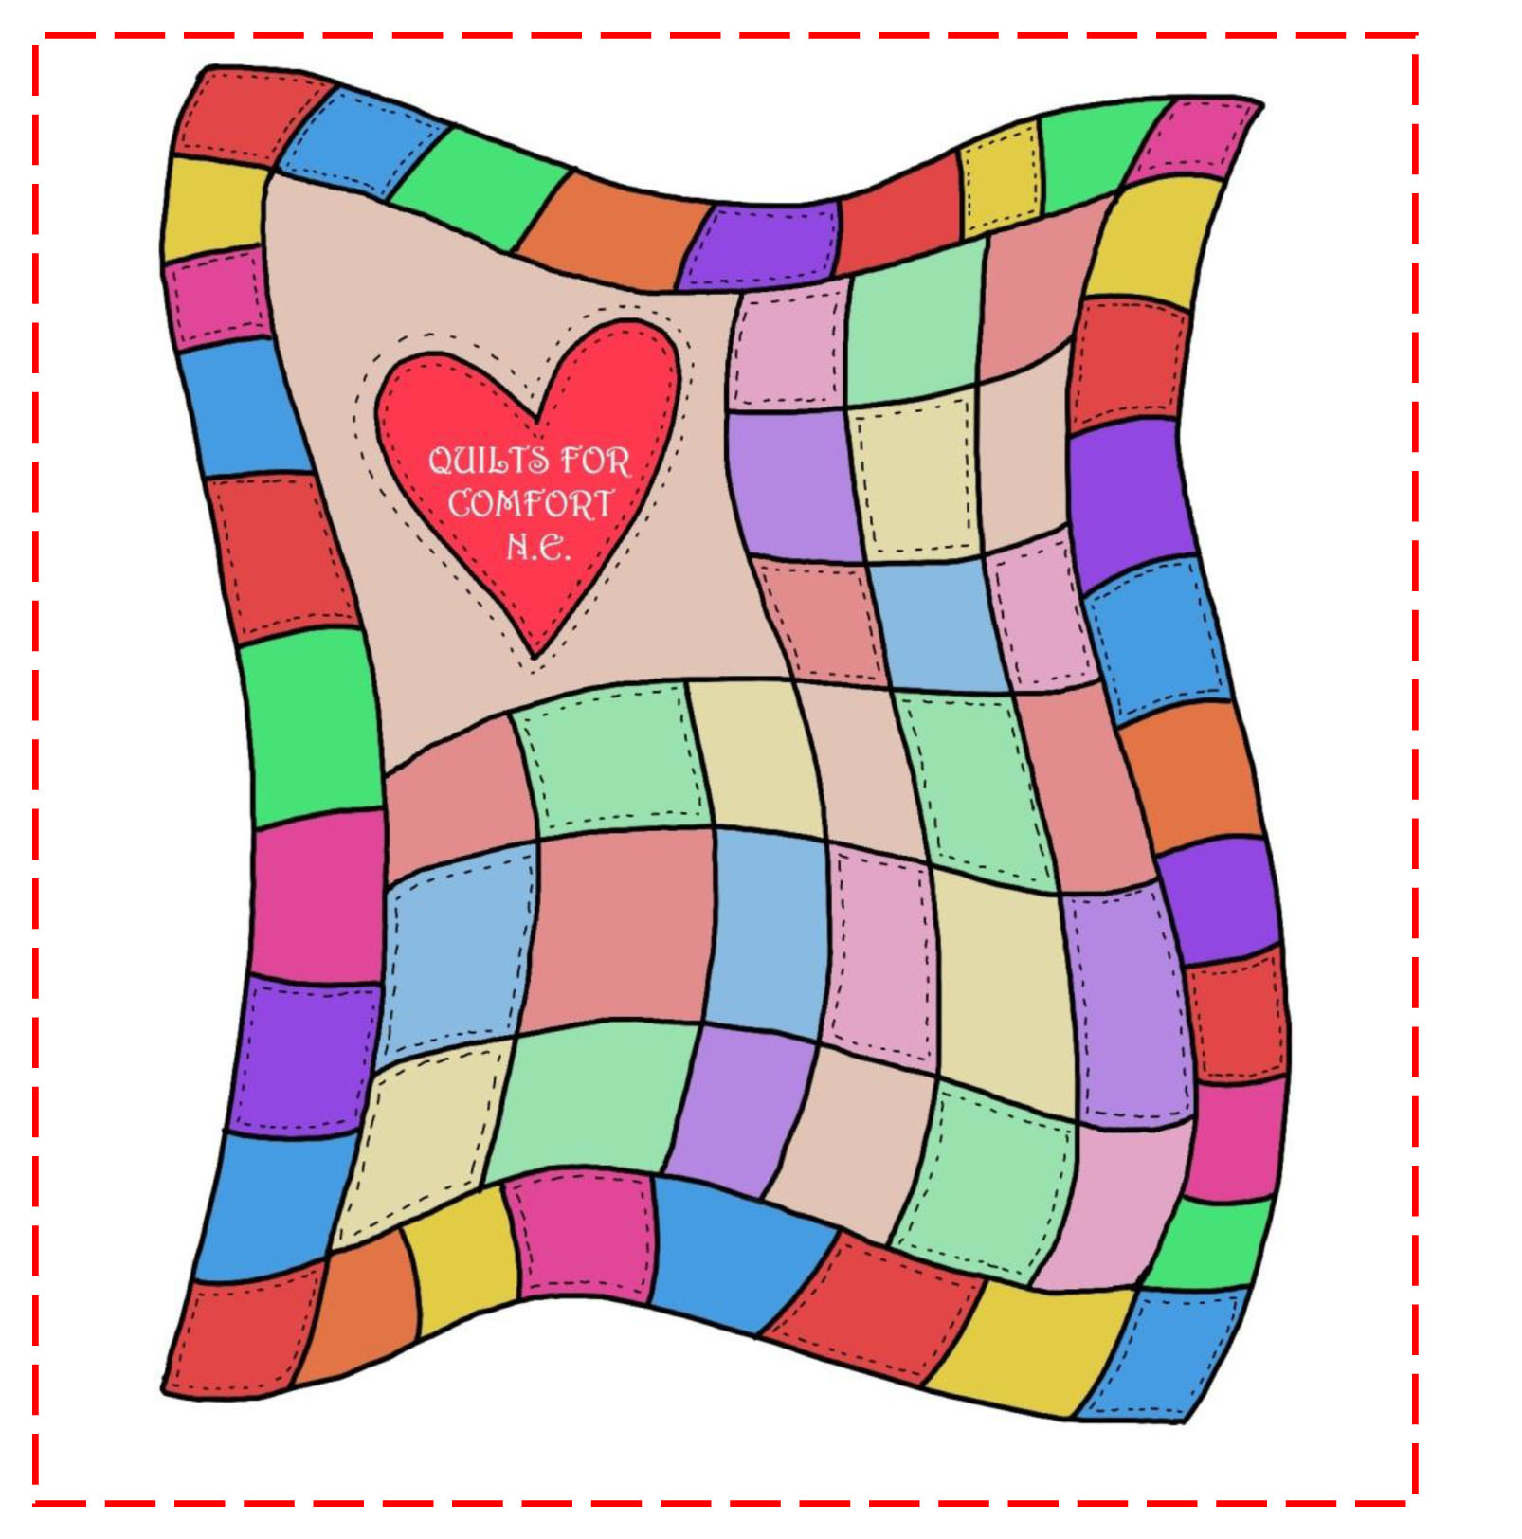
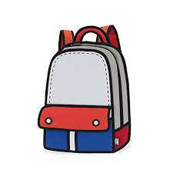

Easy Auction
Logan School Auction Catalog
Fruit Basket
$50
1h 54m left
Concert Tickets
$150
1h 24m left
Sports Equipment
$90
1h 04m left
Handmade Quilt
$60
33m 45s left
Backpack
$45
04m 34s left
My bids:
+
+
+
+

Slide 10
Easy Auction
Fruit Basket
Confirm bid for $51.00 on Fruit Basket?
Confirm
Cancel
1 hr 14 min 32 sec remaining
Top Bidder: n00bmaster69, $50.00
$51.00
Place Bid

Slide 11
Easy Auction
Fruit Basket
1 hr 54 min 32 sec remaining
Top Bidder: n00bmaster69, $50.00
$0.00
Place Bid

Slide 12
Easy Auction
Logan School Auction Catalog
Fruit Basket
$51
1h 54m left
Concert Tickets
$150
1h 24m left
Sports Equipment
$90
1h 04m left
Handmade Quilt
$60
33m 45s left
Backpack
$45
04m 34s left
My bids:
+
+
+

